Slide 1

MODULE 23 RECAP
What We Learned: Finding Structure Without Labels

Slide 2

Module 23 introduced us to the world of unsupervised learning, where we discover hidden patterns without pre-labeled data. This fundamental shift opens new possibilities for organizing and understanding complex datasets.
Clustering Fundamentals
K-Means Algorithm
Core Mechanism
Learned what clustering means and how it fundamentally differs from supervised learning approaches
Explored why K-Means stands as one of the most widely-used clustering methods in data science
Understood how K-Means organizes data using distance calculations and centroids rather than labels
Key Insight: K-Means doesn't predict outcomes—it discovers natural groupings based on similarity patterns within your data.

Slide 3
How K-Means Actually Works
Understanding the algorithm's step-by-step process reveals both its elegance and its sensitivity to initial choices. Each iteration brings us closer to stable, meaningful clusters.
01
02
03
Choose k
Initialize Centroids
Assign Points
Determine the number of clusters you want to identify in your dataset
Use k-means++ for intelligent starting positions that improve convergence
Each data point joins the cluster with the nearest centroid based on distance
04
05
Update Centroids
Iterate to Convergence
Recalculate centroid positions using the mean of all assigned points
Repeat assignment and update steps until cluster assignments stabilize
What We Observed
Critical Insight
Centroids migrate toward dense regions
The algorithm is mathematically straightforward, yet highly sensitive to our initial decisions and parameter choices. Small changes can yield different results.
Assignments stabilize as centroids settle
Simple logic produces complex patterns

Slide 4
Choosing k and Practical Considerations
K-Means requires thoughtful preparation and evaluation. Success depends on understanding both its requirements and its limitations.
Scaling is Mandatory
The Elbow Method
Evaluation Strategies
K-Means relies on distance calculations, making feature scaling essential. Without standardization, features with larger ranges dominate the clustering process, distorting results.
This technique plots inertia against different k values, helping identify the optimal number of clusters. Look for the "elbow" where adding clusters yields diminishing returns.
Since we lack true labels, we use indirect metrics: inertia (within-cluster sum of squares), silhouette scores (cluster separation quality), visualization, and domain expertise.
Remember: A visually appealing cluster plot doesn't guarantee a practically useful model. Always validate results against business objectives and domain knowledge.

Slide 5



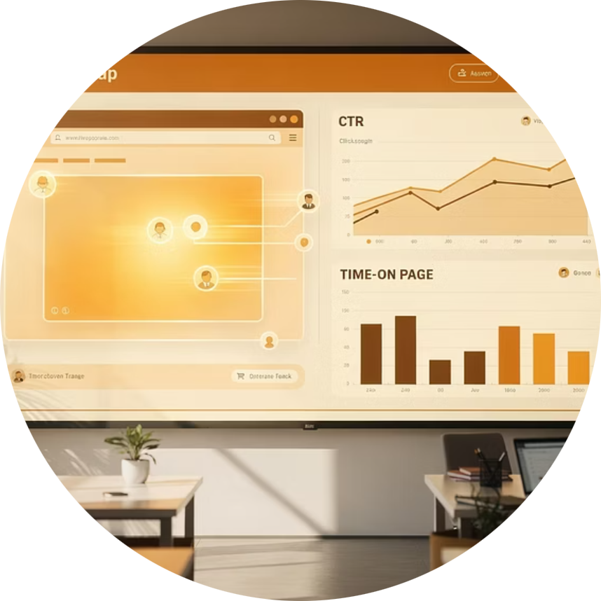

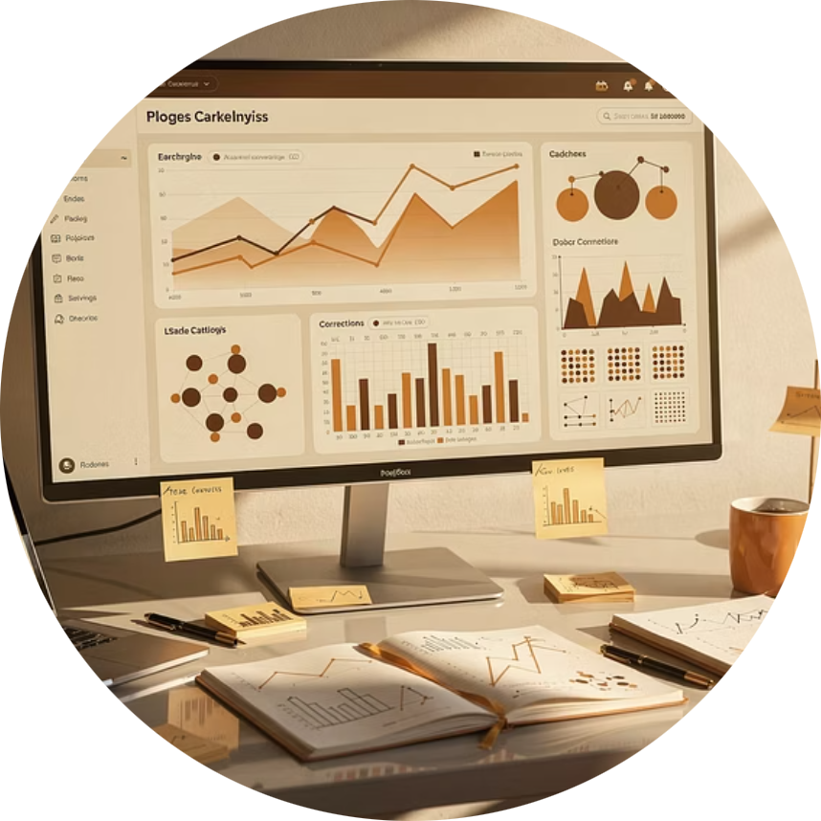
Limitations and Real-World Applications
Where K-Means Excels
Where It Struggles
Compact, spherical cluster shapes
Outliers and noise points
Well-separated groups
Non-spherical, irregular shapes
Large datasets requiring speed
Varying cluster densities
Clear distance-based patterns
When k is fundamentally wrong
Customer Segmentation
Behavior Analysis
Image Compression
EDA Discovery
Group customers by purchasing patterns and preferences
Identify distinct user interaction patterns and journeys
Reduce color palettes while preserving visual quality
Uncover hidden structure during initial data exploration
Final Takeaway: K-Means is a powerful, efficient tool for discovering patterns—but it demands thoughtful application. Use it as part of a broader analytical strategy, not as an automatic solution. Understanding when not to use K-Means is just as important as knowing how to use it.

